Slide 1
Drones for Interactive Performance
MUSC 420 – Capstone Project
Daniel Tsui

Slide 2
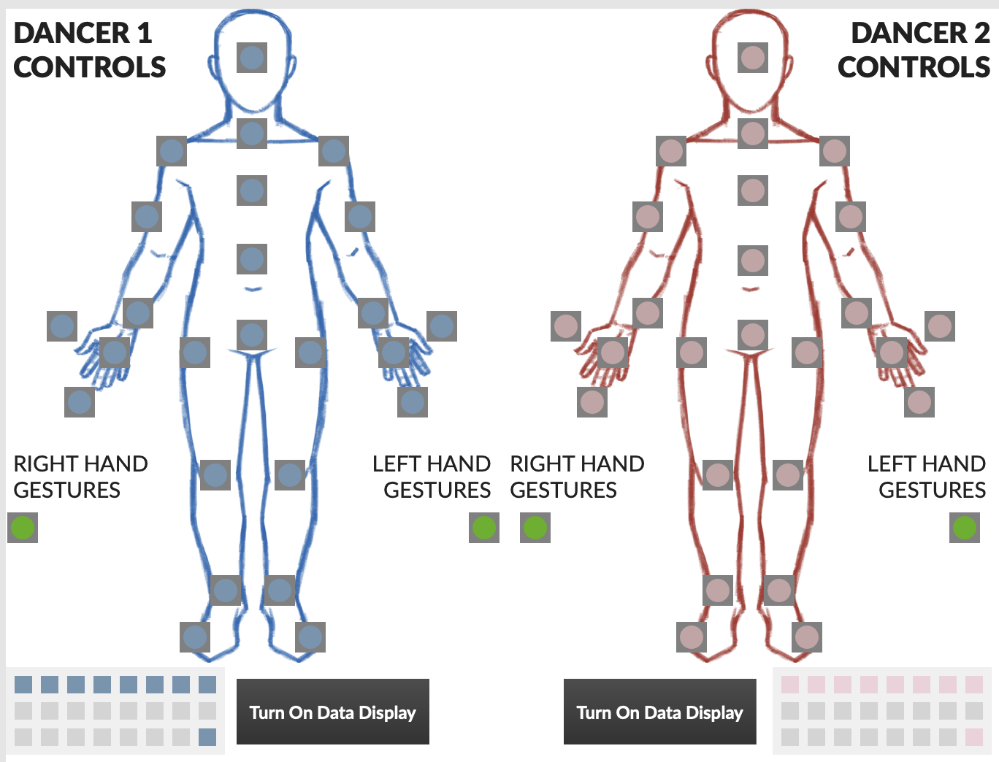
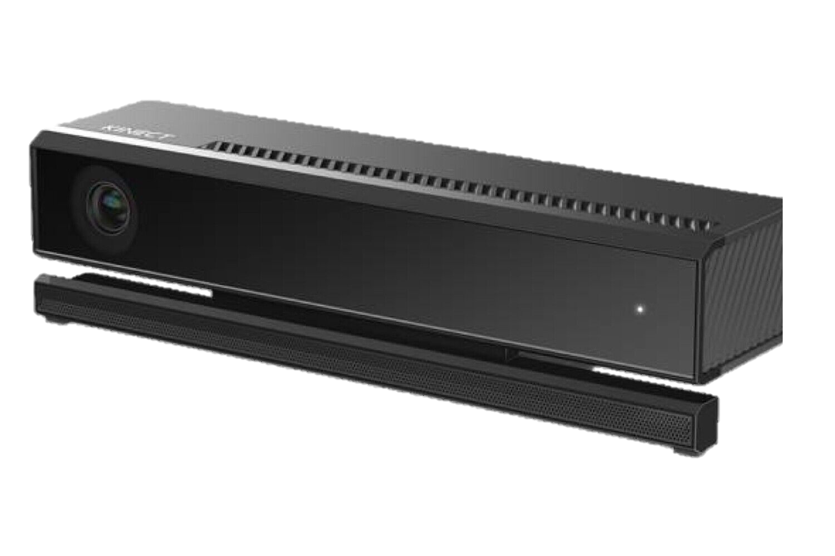
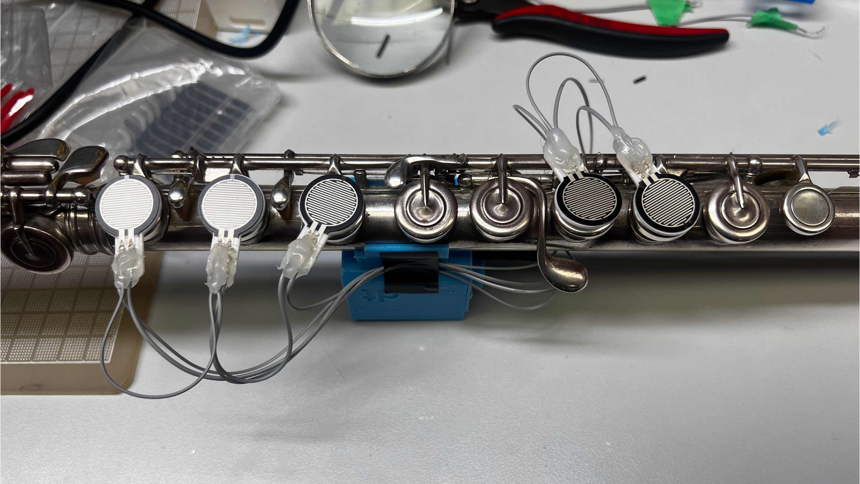
Why?
Seeking for alternative input/output controllers
KiCASS
Kinect-Controlled Artistic Sensing System
WooSIE
Woodwind Sensors For Interactive Environments
Notes:
- We’re constantly seeking for alternative input controllers and output controllers for use in interactive performance
- Input controllers such as, KiCASS (using Kinect for body tracking) and most recently WooSIE, pressure sensitive keys on flute to control aspects of the interactive performance
- In this case, this drone is a part of an aspect for performance on stage

Slide 3
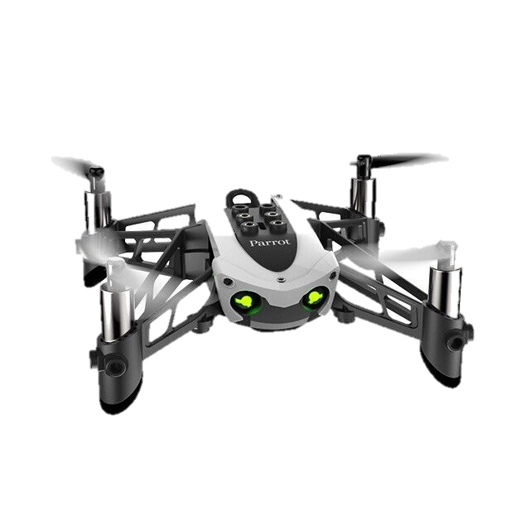
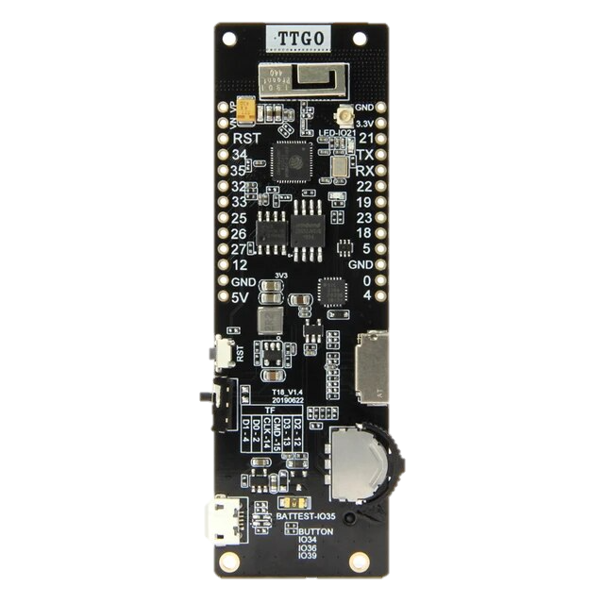





How?
Bluetooth
LE
USB Serial
ESP32
Notes:
Parrot Mambo Minidrone communicates bi-directionally via Bluetooth Low Energy to an ESP32 microcontroller running custom written code.
The ESP32 runs heavily reversed-engineered code to communicate with the drone.
Max bi-directionally communicates with the ESP32 to queue commands to be sent back to the drone.

Slide 4
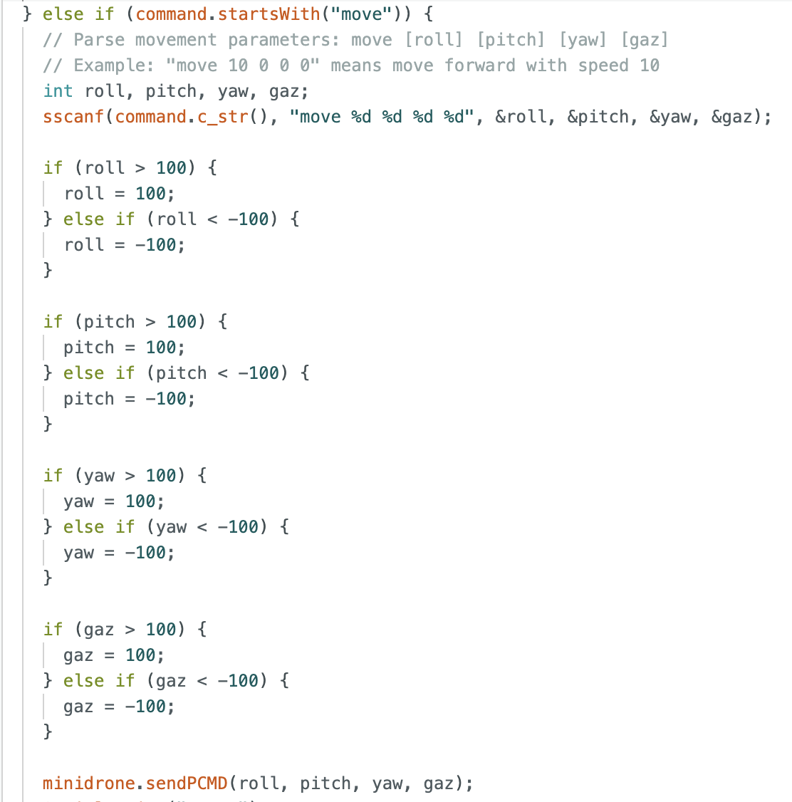
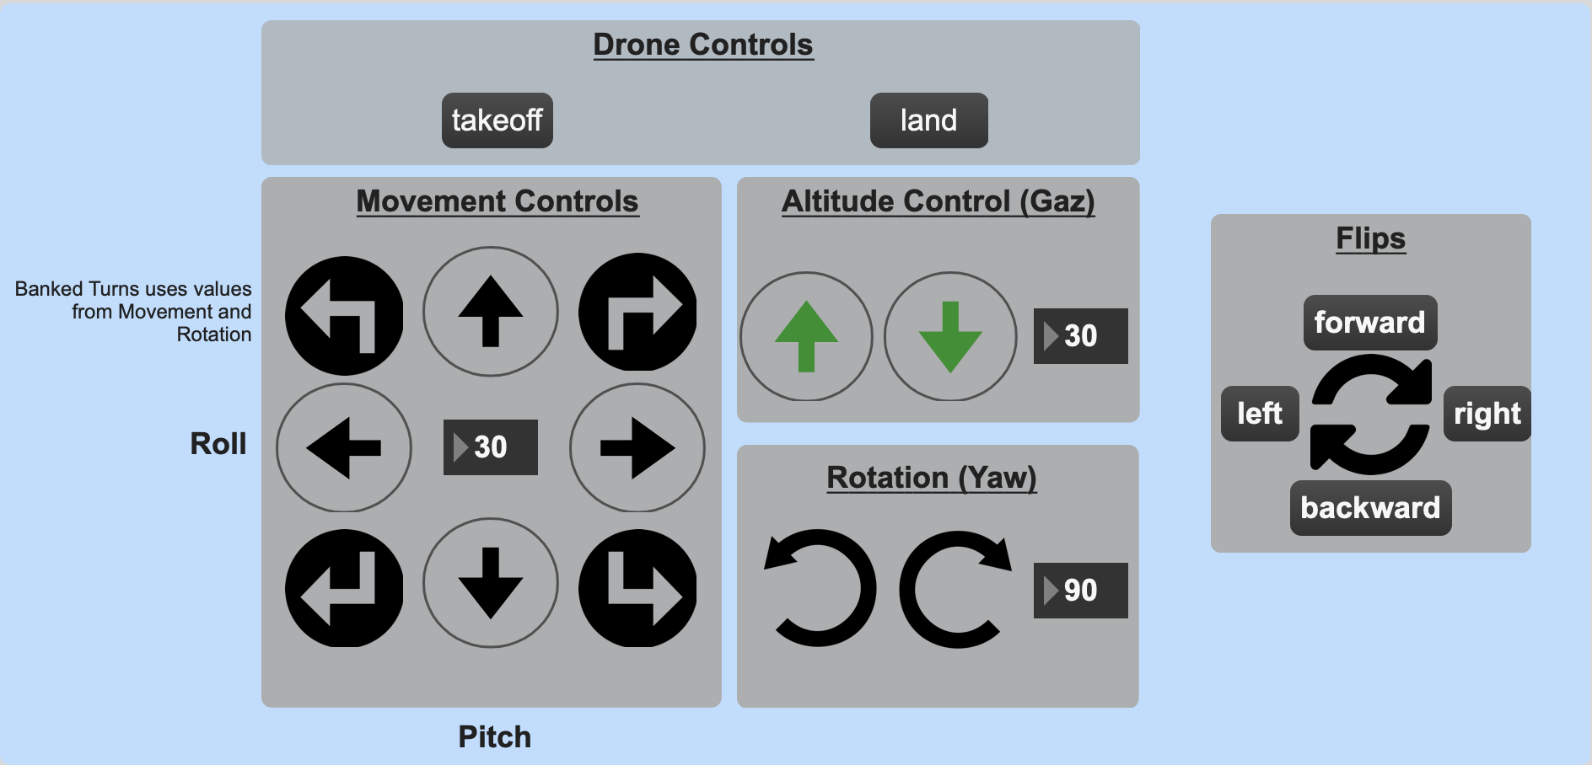
How?
Notes:
What we see here is a short snippet of the Arduino code that handles the movement controls of the drone.
The messages are parsed as roll, pitch, yaw, and altitude values to be sent back to the drone.
On the right hand side, you see a portion of the Max patch, which controls the drone on a basic level.

Slide 5
Challenges
Drone’s API is not documented well
Drone has limited battery runtime
Drone is noisy!
Requires a fresh handshake whenever signal is lost/drone crashes
Notes:
Drone’s API is not documented properly. It took a great amount of time to trial and error the format the Bluetooth messages to what the drone expects. The drone would occasionally ignore all inputs after receiving an malformed message.
The drone doesn’t run for very long. The battery runtime is around 5-10mins max.
Drone is loud! With more time, on its next iteration, toroidal propellers may help with this.
a fresh handshake was required whenever signal is lost/drone crashes. This means the microcontroller would need to reset in these situations.

Slide 6

Result
Bluetooth
LE
USB Serial
ESP32
Notes:
The result?
This opens up the possibilities of linking other interfaces to control the drone. The possibilities of how the drone can be controlled are endless
I will show you a demo of the Max patch interface and a basic usage of Kinect to controlling the drone.

Slide 7
DEMO

Slide 8
Questions?

Slide 9
Thank you!
Notes:
A special thank you to Dr. Bob and Dr. Hamel for all these years of guidance and for overseeing this project!

